Slide 1
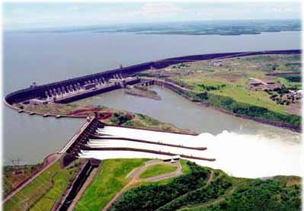
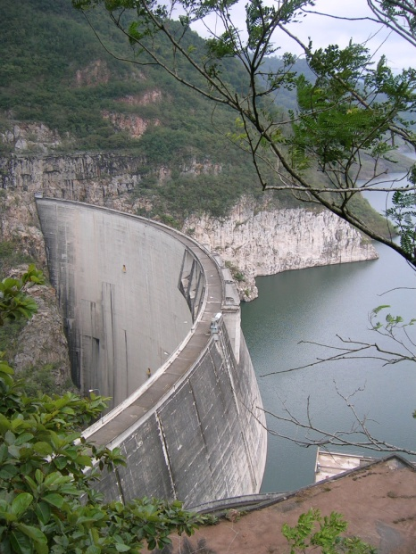
Dams and Reservoirs
Power, Poverty, and Green

Slide 2
Dam Functions
Hydropower
Flood control
store runoff for later release
protect against sea storm surges
Reservoir
irrigation
municipal water supply
Recreation
Global warming?
Multiple conflicting functions!

Slide 3
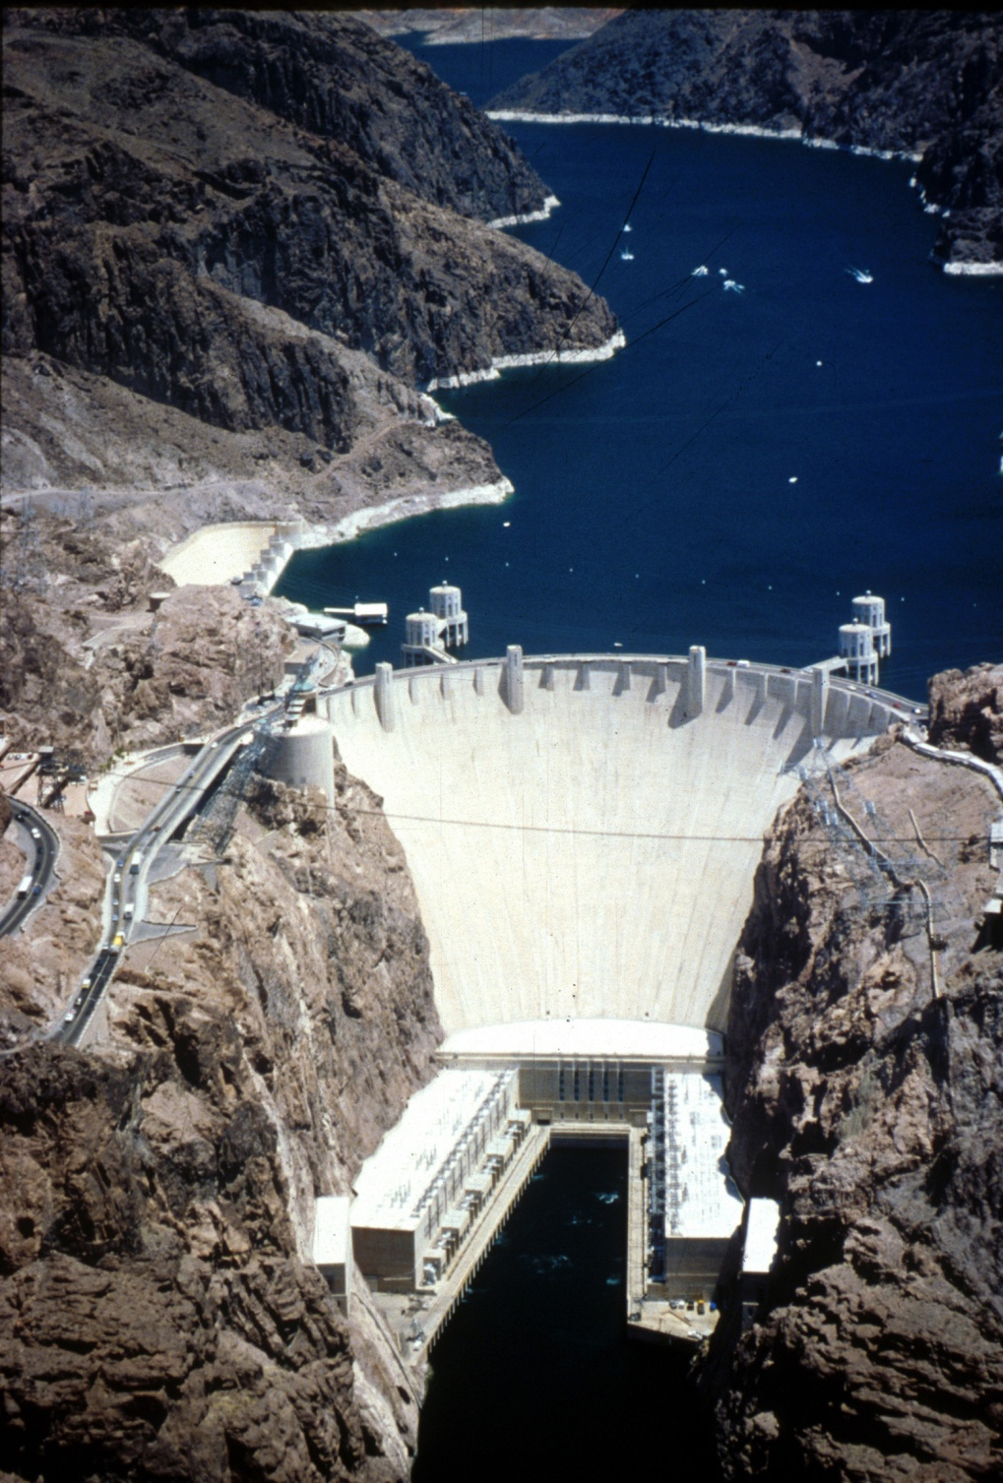
Hoover Dam
General
Dam type: Concrete thick arch
Location: 7 mi northeast of Boulder City NV
Watercourse: Colorado River
Reservoir: Lake Mead
Original construction: 1931-36
Dimensions
Structural height: 726.4 ft
Crest elevation: 1232.0 ft
Crest length: 1,244 ft
Crest width: 45 ft
Base width: 660 ft
Volume of concrete: 4,400,000 cu yd
Hydraulics
Total storage to El. 1221.4:
28,537,000 acre-ft
Hydraulic height: 576 ft
Service spillway capacity limited to 260,000 cfs
Hydrology
Drainage area: 167,800 sq mi
HMR: N/A
PMF: 1989 PMF - August general storm with 100-year snowmelt
PMF Volume: 9,349,000 acre-feet over 60 days
Peak inflow: 1,130,000 cfs
35 km³
Boulder Canyon
http://borworld.usbr.gov/cdams/dams/hoover.html

Slide 4
Netherlands: Storm Surge Barrier
Movable dam at Rotterdam
Protection against sea storm surges
2-210 m lattice arms attached to radial gates that swing out into the channel
Gates will shut based on predicted storm surge (take 10.5 hours to close)
Expected to be used once every 10 years
Global warming could increase usage...
After closure river-side water level will rise
Gates will never be closed for more than 30 hours

Slide 5
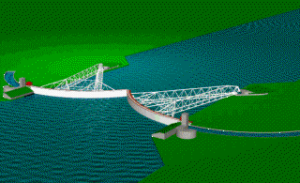
Storm Surge Barrier
pivot point
river
ocean
port facility
http://park.org/Netherlands/pavilions/techno/svk/engels/index.html

Slide 6
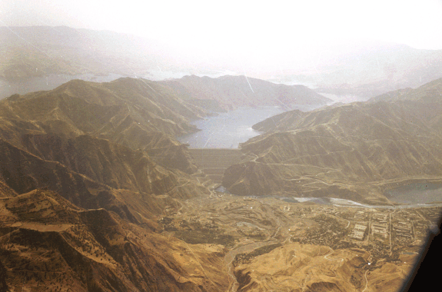
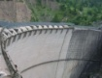
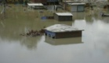
World’s Tallest Dams
Name River Country Type Height (m) Year
Rogun Vakhsh Tadjikistan E-R 335 UC
Nurek Vakhsh Tadjikistan E 300 1980
Grand Dixence Dixence Switzerland G 285 1961
Inguri Inguri Georgia A 272 1980
Vajont Vajont Italy A 262 1960
Manuel M. Torres (Chicoasen) Grijalva Mexico E 261 1980
Tehri Bhagirathi India E 261 2003
Alvaro Obregon (El Gallinero) Tenasco Mexico G 260 1946
Mauvoisin Drance de Bagnes Switzerland A 250 1957
Alberto Lleras C. Guavio Colombia R 243 1989
R = Rockfill
E-R = Earth and Rockfill
G = Gravity
A = Arch
UC = Under Construction
http://blume.stanford.edu/~npdp/npdp.html
Source: USCOLD Register of Dams

Slide 7
Largest Hydropower Projects
Name River Country Capacity (MW) Year
Three Gorges Yangtze River China 18200 2009
Itaipu Parana Brazil/Paraguay 12600 1983
Guri Caroni Venezuela 10300 1986
Sayano-Shushensk Yenisei Russia 6400 1989
Grand Coulee Columbia U.S.A. 6180 1942
Krasnoyacsk Yenisei Russia 6000 1968
Church Falls Churchill Canada 5428 1971
La Grande 2 La Grande Canada 5328 1979
Bratsk Angara Russia 4500 1961
Ust-Ilim Angara Russia 4320 1977
Tucurui Tocantins Brazil 3960 1984

Slide 8
China: Three Gorges project
Flood Control: The Three Gorges reservoir has a flood storage capacity of 22.15 km³
Reservoir capacity is 39.3 km³
Peak flood discharge of 124,300 m³/s
Power Generation: With a total installed capacity of 18,200 MW, will replace about 40 million tons of coal per year
Navigation: 660 km-long deep water channel to be formed by the reservoir backwater.
map

Slide 9
Three Gorges - Cons (Environmental Defense Fund)
Relocate between 1.2 and 1.9 million people
620,000 acres of farmland will be lost
Cost more than $26 billion
8,000 cultural sites will be flooded
The U.S. Bureau of Reclamation withdrew its technical assistance for the project
U.S. Export-Import Bank refused support for the project based on human rights and environmental concerns.
German, Swiss, and Canadian export credit agencies have provided financial support for the project

Slide 10
China: a Water Industrial Complex
Despite large dam criticisms and controversies, China continues to follow its faith in the superiority of large-scale engineering and technocratic approach to water management.
In the last fifty three years, China has constructed more than 22,000 of the world’s 45,000 large dams and it continues to be the fastest dam building country in the world.
http://openflows.org/~jamyang/Water_Industrial_Complex.htm

Slide 11
Canada
61% of electricity was generated by hydropower (1994)
Hydro generating capacity of 63 gW
Quebec (advertisement in Hydro Review)
96% of electricity is generated by hydropower, has reduced its total CO₂ emissions by 17.4% over the last 20 years.
The US and the rest of Canada produce twice as much CO₂ per capita as Quebec
By using hydropower from Quebec, utilities in Canada and the United states can help reduce the threat of global warming for all of us.
(Please buy our electricity...)

Slide 12
La Grande Complex
Begun in 1971
68,000 square mile drainage basin of northern Quebec (size of New England)
Plan series of 9 dams
goal: total of 15.7 gW generating capacity
LG 2 5,328 MW completed in 1985
LG 3 2,304 MW
LG 4 2,651 MW
LG 1 1,368 MW completed July 1995
map

Slide 13
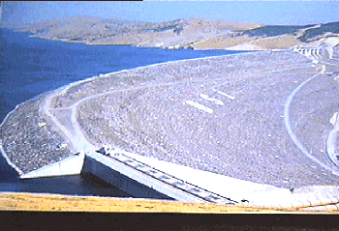
The Atatürk Dam and HEPP
The Atatürk Dam is the largest structure ever built in Turkey for irrigation and hydropower generation. It is located on the Euphrates river and constitutes the key unit in the Southeastern Anatolia Project (GAP).
Who owns the water?
GAP

Slide 14
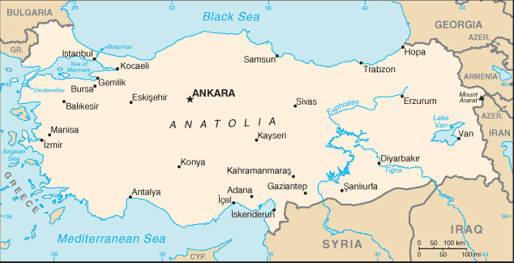
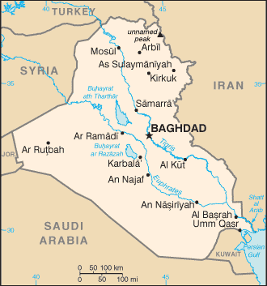
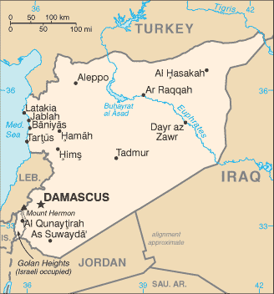
Euphrates River

Slide 15
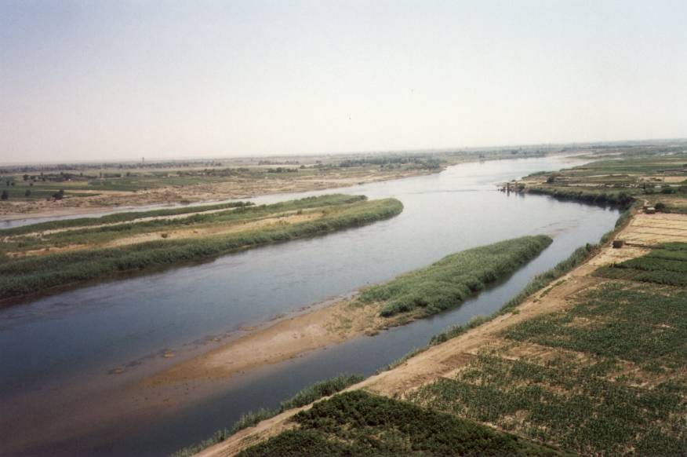
Euphrates river in Syria
Notes:
http://mikulastik.net/sy/img/2002_9154-24.jpg

Slide 16
USA HydroPower
DAM NAME RIVER LOCATION MW
Grand Coulee Columbia Washington 6180
Chief Joseph Columbia Washington 2457
John Day Columbia Oregon 2160
Bath County P/S Little Back Creek Virginia 2100
Robert Moses - Niagara Niagara New York 1950
The Dalles Columbia Oregon 1805
Luddington Lake Michigan Michigan 1657
Raccoon Mountain Tennessee River Tennessee 1530
Hoover Colorado Nevada 1434
Pyramid California Aqueduct California 1250
USBR

Slide 17
Paraguay: big hydropower!
Itaipú Dam on the Paraná river
18 generators produce 12.6 gW
Cost 18.3 billion dollars to build
Construction 1974 to 1985
Dam spans nearly 5 miles
28 million tons of concrete
Enough electricity to meet all of Paraguay’s present-day power needs + 1/3 of Brazil’s!
Hoover 1200 ft
6.6 million tons
Itaipu

Slide 18
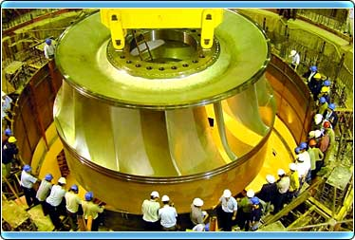
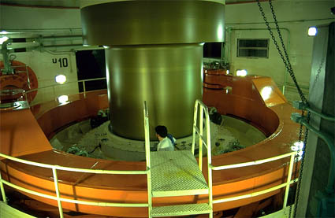
Itaipú Turbines
The water intake of one single 715 MW Francis-turbine is 645 m³/s
Turbine efficiency is 93.8%
92.3 rpm
Diameter is almost 16 m
118.4 design head
Draft tube

Slide 19
Itaipú – Diesel Generators?
El 40- Foundation of the dam
El 92,4- Access to turbine pit
El 98,5- Unit auxiliary service - Pure water system
El 98,5- Excitation system, access to generator housing and speed governor
El 108- Step-up transformers
El 108- Generator hall floor and local control rooms
El 122- Ventilation system
El 127,6- Cable gallery
El 128,2- GIS - SF6
El 133,2- Principal panels of AC auxiliary service and diesel generator hall
El 144- Dam auxiliary service
El 214- Gate hydraulic pump group

Slide 20
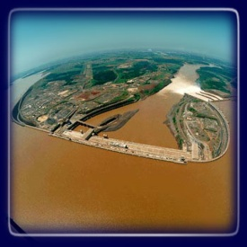
Itaipu Power Generation
Parameters
Itaipu
Three Gorges
Turbines
18 (700MW)
26 (700MW)
Installed power
12,600 MW
18,200 MW
Annual production
93.4 billion kWh/year
84.68 billion kWh/year
Concrete employed
12.57 million m³
27.94 million m³
Height
196 meters
181 meters
Length of the dam
7,700 meters (concrete, rockfill and earth)
2,309 meters (only concrete)
Spillway: capacity
62,200 m³/s
102,500 m³/s
Excavations
63.85 million m³
113 million m³
Reservoir
Length Área
170 km 1,350 km²
600 km 1,084 km²
Number of people resettled
4 thousand
1.1 million

Slide 21
Itaipu versus Three Gorges
Itaipu will continue for many years to be the greatest hydro plant in the world regarding the most important feature of a plant of this type: energy production.
Even before utilizing the two additional generator units, to be installed by 2004, Itaipu already attained the production milestone of 93.4 billion kWh/year,
The forecast for the Three Gorges is 84 billion kWh/year (9.6 gW average)

Slide 22
Itaipu versus Three Gorges
In summary, in spite of having less installed power than Three Gorges and with eight fewer generator units, Itaipu has a greater production than that specified in the project of the Chinese hydro plant.
This record can only be maintained because Nature is on our side. The flow of the Paraná River is more stable than that of the Yang-tse,
The waters of our "Great Paraná" are regulated by dozens of power plants located upstream form Itaipu.

Slide 23
Optimal Generating Capacity?
Why is the average production of Three Gorges only 9.6 gW while installed capacity is 18.2 gW?
Identify the important parameters
Contrast run of the river (Fall Creek power plant) with reservoir operation
Why might you build generating capacity in excess of average production?
What analysis would need to be performed to determine how much generating capacity should be installed?

Slide 24
Fall Creek Flow
3.5

Slide 25
Hydropower Advantages
Renewable
No CO₂ production
Quick response to changing demand
Ideal for providing peak demands
Potential Energy storage

Slide 26
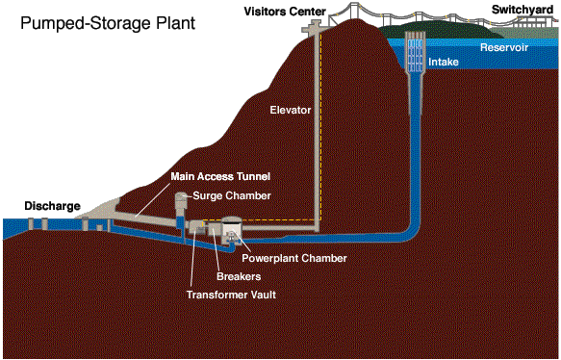
Pumped-storage
Pumped-storage utilizes two reservoirs, one located at a much higher elevation than the other. During periods of low demand for electricity such as nights and weekends, energy is stored by reversing the turbines and pumping water from the lower to the upper reservoir. The stored water can later be released to turn the turbines and generate electricity as it flows back into the lower reservoir.

Slide 27
Large Dams
What motivates the construction of large dams?

Slide 28
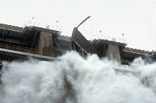

Dam Dis-functions
Dis-functions
Call for International Moratorium on Large-Dam Building
http://www.irn.org/programs/pr970317.html

Slide 29
Hydropower Research Issues
Fish friendly turbines to improve fish passage survival rates
Gas supersaturation
can occur when water is spilled to aid downstream migrating salmon
water deep in the reservoir can be supersaturated with gases

Slide 30
Dam Design Issues
Dam stability
Resist ice forces
overturning/sliding
uplift
Sufficiently impermeable to prevent significant leakage
erosion of dam material
piping: water erodes material making path more permeable
Spillway
dissipate energy
prevent undermining of dam structure

Slide 31
Forces on Dams
Hydrostatic forces
Weight of dam
Earthquake forces F=ma
m is the mass of the dam
a is the acceleration due to the earthquake
design value of 0.05 g to 0.10 g
Wave forces
Ice forces (small dams)
Large reservoirs

Slide 32
Stability analysis
don’t overturn
don’t slide
don’t exceed allowable stress of concrete
don’t put unreinforced concrete in tension
consider different load combinations
high water
overflow
earthquake
Friction coefficient

Slide 33
Dams: Hydrostatic forces
h_{u}
F_{U,V}
F_{U,H}
h_{d}
A=
forces per unit width
Increase A, increase stability

Slide 34
Hydrostatic Uplift
h_{u}
h_{d}
F_{uplift}
Uplift pressure gradient

Slide 35
Reduce Hydrostatic Uplift
h_{u}
h_{d}
Grout curtain
F_{uplift}
Uplift pressure gradient

Slide 36
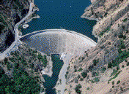
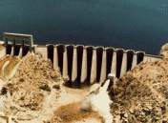
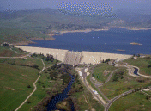
Types of Dams
Material
Earth
Rockfill
Concrete
Configuration (transfer of forces)
Must be gravity
Arch
Buttress
Gravity
http://www.usbr.gov/cdams/main.html

Slide 37
Earth
fine material
filter material
free board
course material
rip-rap
pervious foundation
Prevent erosion especially at water surface
Rock

Slide 38
Rockfill Dams
bedding layer to support facing
3-4
1
compacted rock material
waterproof facing
footwall
bedrock
grout curtain
Reduce hydrostatic uplift and leakage

Slide 39
Concrete Dams
concrete is a more expensive material than on site materials
offers more resistance to compressive forces
shape can be designed to minimize concrete usage
the bigger the dam the more sophisticated the design becomes
Types of concrete dams
gravity
arch
buttress

Slide 40
Arch
Top width
Narrow locations (canyons)
Hydrostatic forces are transmitted into side walls and bottom
Requires solid rock
Finite element analysis of stress
< 5
Height

Slide 41
Buttress
Hollow gravity dam
Weight of the water above the sloping face provides stability
Use 30-40% of concrete needed for a gravity dam
Require much more form work
reinforced concrete slab
struts

Slide 42
Dam construction: river management
River diversion
Itaipú - 1.3 mile long channel: 50 million tons of rock
Cofferdams: watertight enclosure constructed and pumped dry to provide a place to work. (see coffin!)
requires staging
La Grande project example
Tunnels
used in narrow canyons
tunnel in canyon walls
sometimes part of diversion tunnel can be used later as the spillway tunnel. (Hoover Dam)
Design flood?

Slide 43
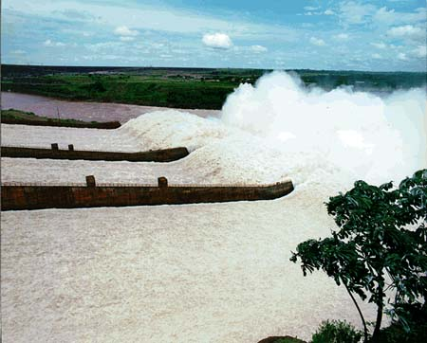
Spillways
Dissipate excess energy
Designed to prevent downstream erosion
http://www.itaipu.gov.br/fotos/vert1.jpg

Slide 44
Dam Freeboard Requirements
Freeboard is critical in earthen dams!
Waves
Setup or wind tide
Dam settlement
Safety factor

Slide 45
Reservoirs
flood storage
flood stage reservoir level
Artificial lakes
Inflow
river
pumps
Outflow
usually controlled
function of demand
hydroelectric, water supply, irrigation, streamflow
normal maximum reservoir level
useful storage
minimum reservoir level
T
dead storage

Slide 46
Largest Reservoirs by Volume in the US
DAM NAME RESERVOIR LOCATION Volume (km³) Year
Hoover Lake Mead Nevada 34.85 1936
Glen Canyon Lake Powell Arizona 33.30 1966
Garrison Lake Sakakawea North Dakota 27.92 1953
Oahe Lake Oahe South Dakota 27.43 1958
Fort Peck Fort Peck Lake Montana 22.12 1937
Grand Coulee F D Roosevelt Lake Washington 11.79 1942
Libby Lake Koocanusa Montana 7.17 1973
Fort Randall Lake Francis Case South Dakota 5.70 1952
Shasta Lake Shasta California 5.61 1945
Toledo Bend Toledo Bend Lake Louisiana 5.52 1968
Source: USCOLD Register of Dams
http://www2.privatei.com/~uscold/uscold_s.html
http://earthobservatory.nasa.gov/Study/LakeMead/
Decommission Glen Canyon? http://www.sdearthtimes.com/et0203/et0203s6.html

Slide 47
Reservoir Operation for Multiple Uses Including Flood-Control
Keep reservoir level at or below the rule curve
In case of flood, limit outflow to 225 m³/s until reservoir is again at or below the rule curve
The rule curve is high between July 31 and September 15 because flooding is rare that time of year
conditional flood control space
3
2.9
2.8
2.7
rule curves
Storage Mm³
2.6
2.5
2.4
15-Sep
31-Oct
20-Mar
31-May
31-Jul
choice of rule curve depends on anticipated volume of snow melt

Slide 48
Reservoir Mass Balance Equations
Cumulative
inflow
Cumulative
outflow
Initial storage
+
=
+
Storage
D_{i}=
Cumulative Demand from reservoir
R_{i}=
Cumulative River flow
S_{i} can never be greater than maximum reservoir volume

Slide 49
Waste from Reservoir?
Simplest operating rule
Waste from reservoir when reservoir is full
Don’t waste from reservoir if reservoir isn’t full
More complex rules could easily be incorporated into a spreadsheet model
minimum discharge into river as a function of reservoir storage volume

Slide 50
Simple Reservoir Rules in Equation Form
When is reservoir full?
Reservoir overfull
Excess to river
Nothing to river
S_{max}=
Reservoir capacity
Cannonsville Reservoir

Slide 51
Storage vs. Safe Yield for Cannonsville Reservoir
Asymptote of long term mean flow

Slide 52
Reservoir Evaporative losses
Given pan evaporation data (E_{p})
Convert to lake evaporation data (E_{L} = 0.7E_{p})
What is area of lake?
Calculate losses from evaporation
Add evaporative losses to Outflow

Slide 53
Global Hydropower
At the global scale, current levels of hydropower generation offset 4.4 million barrels of oil-equivalent (thermal electric generation) a day, roughly 6% of the world’s oil production
http://www.dams.org//docs/report/wcdch1.pdf

Slide 54
Decommissioning Dams
The end of the 20th century saw the emergence of another trend relating to large dams – decommissioning dams that no longer serve a useful purpose, are too expensive to maintain safely, or have unacceptable levels of impacts in today’s view.
Momentum for river restoration is accelerating in many countries, especially in the United States where nearly 500 dams, mainly relatively old, small dams have been decommissioned.
Since 1998, the decommissioning rate for large dams has overtaken the rate of construction in the United States.
http://www.dams.org//docs/report/wcdch1.pdf

Slide 55
Reservoir Capacity and Sedimentation
The aggregate storage capacity of large dams, based on dam design, is about 6 000 km³
Assuming that half the design storage is achieved in reality, the aggregate real storage capacity of large dams globally is similar to total freshwater withdrawals estimated at around 3 800 km³
An estimated 0.5–1% of the total fresh water storage capacity of existing dams is lost each year to sedimentation in both large and small reservoirs worldwide
This means that 25% of the world’s existing fresh water storage capacity may be lost in the next 25 to 50 years in the absence of measures to control sedimentation
This loss would mostly be in developing countries and regions, which have higher sedimentation rates.
http://www.dams.org//docs/report/wcdch1.pdf

Slide 56
Reservoir Resettlers
The construction of large dams has led to the displacement of some 40 to 80 million people worldwide.
Many of them have not been resettled or received adequate compensation, if any.
The world’s two most populous countries – China and India, have built around 57% of the world’s large dams – and account for the largest number of people displaced.
In the late 1980s China officially recognized some 10.2 million people as ‘reservoir resettlers’, though other sources suggest the figure may be substantially higher.
Large dams and reservoirs already built in the Yangtze basin alone have led to the relocation of at least 10 million people.
In India, estimates of the total number of people displaced due to large dams vary from 16 to 38 million people.
http://www.dams.org//docs/report/wcdch1.pdf

Slide 57
Why are Dams Opposed?
Large dams represent major investments, and in some cases may be the largest single investment in a country. These investments are essentially irreversible and often highly politically charged.
Large dams are generally justified by national or regional macro-economic benefits while their physical impacts are locally concentrated, mostly affecting those within the confines of the river valleys, and along the river reaches. The mismatch of benefits and costs translates easily into confrontational attitudes.
Resettlement for large dams tends to be on a larger scale than resettlement for other types of physical infrastructure. Roads and thermal power stations can be sited on marginal land whereas dams generally flood rich and fertile agriculture land.

Slide 58
Why are Dams Opposed?
Those resettled from dam or reservoir sites very often lose not only their homes but also their livelihoods. Relocation in rural settings where good land is already occupied can be problematic. n Large dams affect critical, life sustaining resources, such as land, fisheries and the quality and allocation of freshwater, an increasingly scarce and coveted resource.
Lack of adequate and accepted solutions to the social and environmental impacts of large facilities has resulted in increased social mobilization around these issues.
The lower than anticipated economic performance of many projects.

Slide 59
Reflections
What is the difference between small dam projects and megadam projects?
Should we decommission more dams?
“One of the central problems – and certainly one of the main causes of stalemate in the debate – is the lack of mutual trust between the key parties involved”
http://www.dams.org//docs/report/wcdch1.pdf

Slide 60
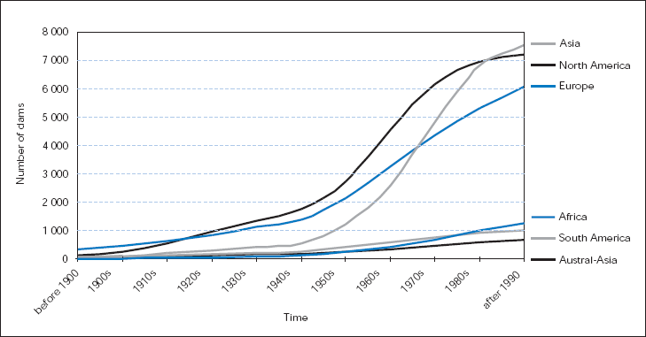
Summary
Motivation for building Dams
Environmental impacts of Dams
Types of Dams
Reservoir Operation
http://www.dams.org/report/contents.htm

Slide 61
Nurek, Tadjikistan

Slide 62
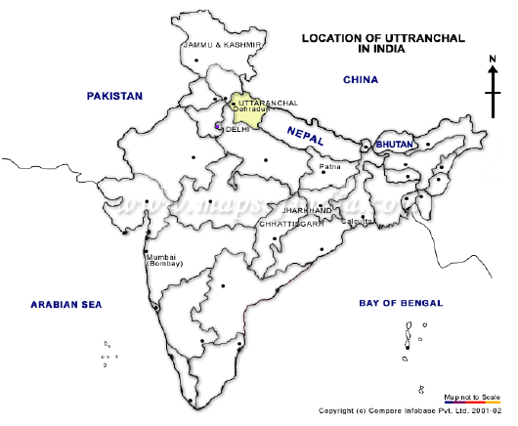
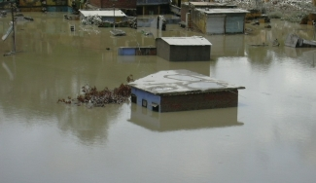
Tehri
http://www.uttaranchal.ws/sinking_tehri.htm
http://www.irn.org/programs/india/021022.tehrifactsheet.pdf

Slide 63
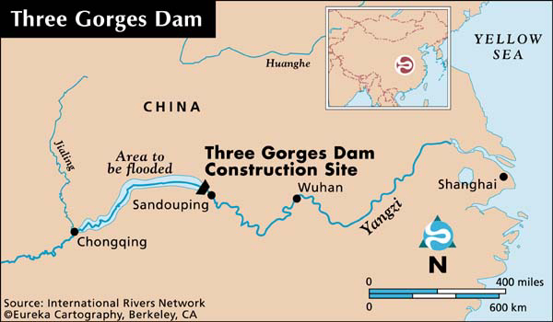
Three Gorges Dam Location

Slide 64
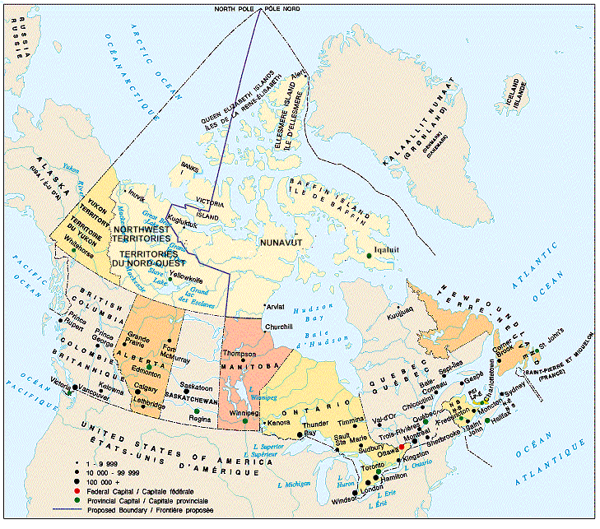
Map of Canada

Slide 65
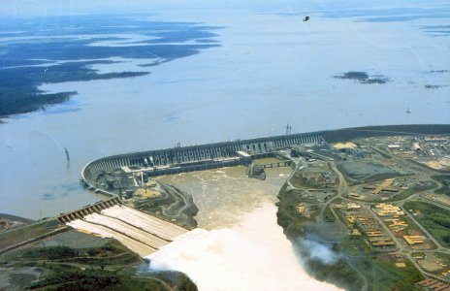
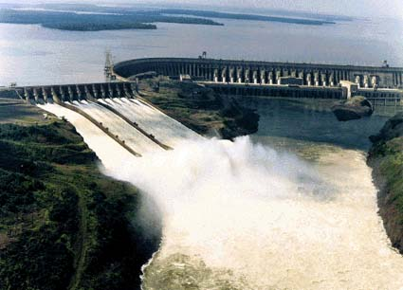
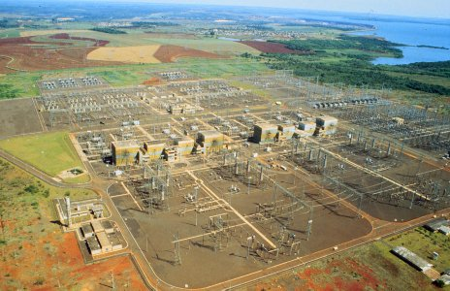
Paraguay - Itaipu
http://www.abb.se/pow/l1342.htm
http://pharos.bu.edu/Egypt/Wonders/Modern/itaipu.html

Slide 66
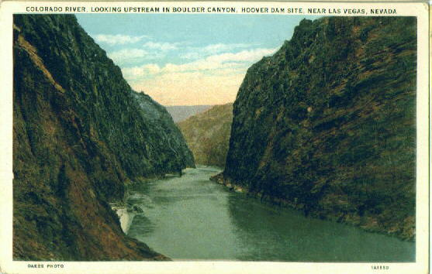
Boulder Canyon

Slide 67
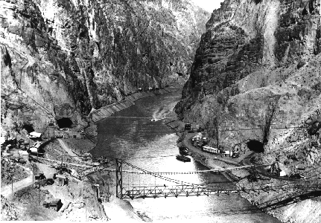
Boulder Canyon

Slide 68
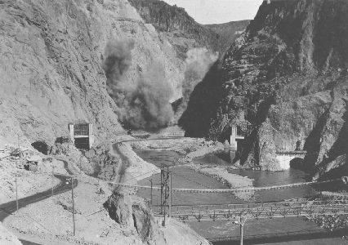
Explosion in Canyon

Slide 69
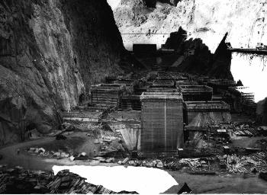
Setting the Foundations

Slide 70
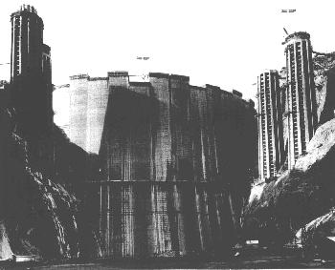
Intake Towers

Slide 71
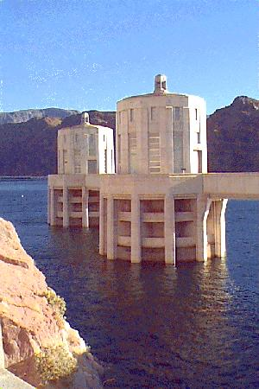
Intake Towers

Slide 72
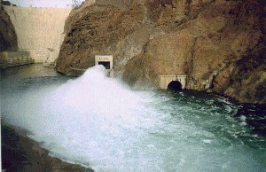
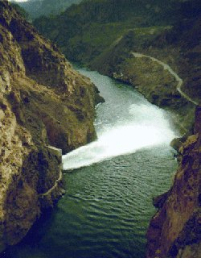
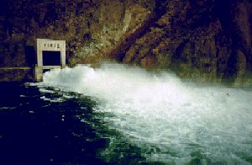
Flood Release
Twelve obsolete needle valves were replaced with new jet flow gates in the outlet works at Hoover Dam to meet criteria that require the dam to release 73,000 cfs without using the spillways.
The outlet works had a release capacity of about 50,000 cfs

Slide 73
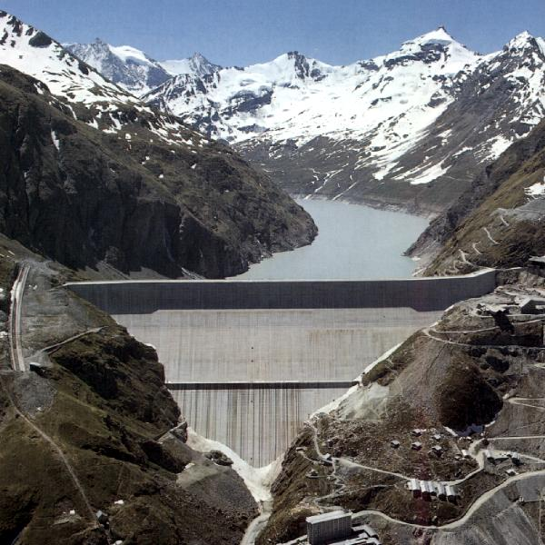
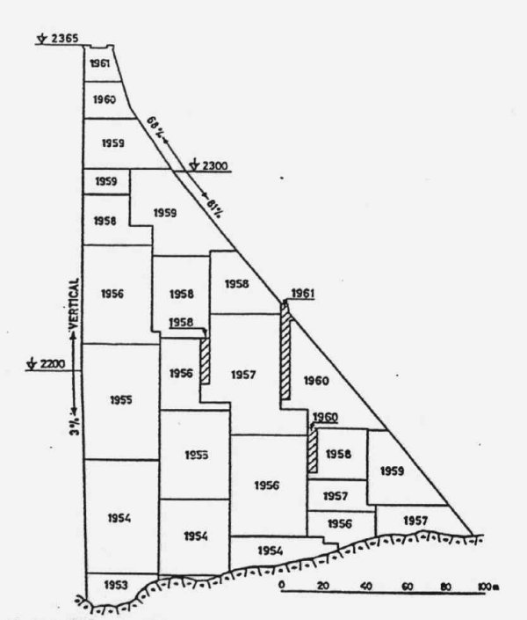
Grand Dixence
http://www.swissdams.ch/Dams/damPicts/large/Grande%20Dixence_01.jpg

Slide 74
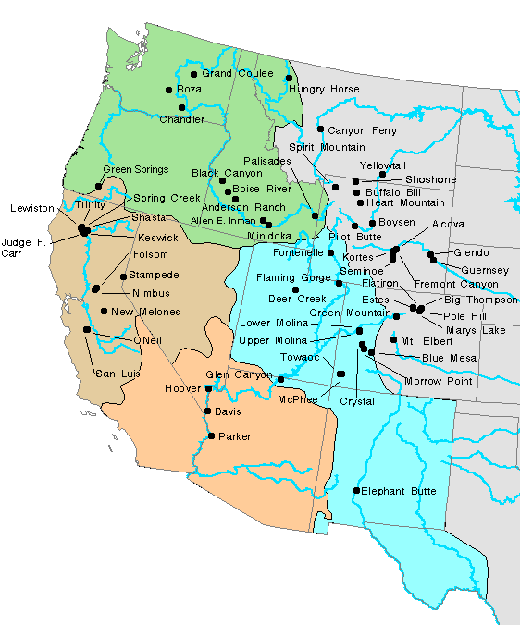
Bureau of Reclamation
the Nation's second largest hydroelectric power producer
59 hydroelectric power plants
installed capacity of over 14 gigawatts
42 billion kWh/year of hydroelectric energy
enough to meet the annual needs of 14 million people.

Slide 75
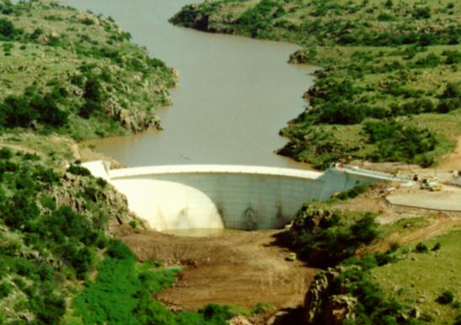
Mountain Park Dam
Dam type: Concrete double curvature thin arch
Location: 6 miles northwest of Snyder, Oklahoma
Watercourse: West Otter Creek
Reservoir: Tom Steed
Original construction: 1973-75
http://www.usbr.gov/cdams/dams/mountainpark.html

Slide 76
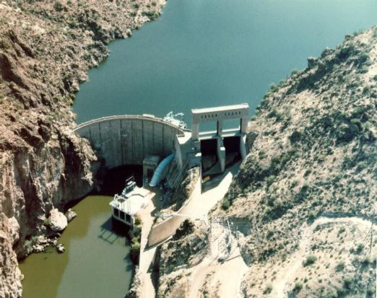
Mormon Flat Dam
Dam type: Concrete thin arch
Location: 51 miles northeast of Phoenix, Arizona
Watercourse: Salt River
Reservoir: Canyon Lake
Original construction: 1923-26
Modified in: 1937-38, 1969-72
http://www.usbr.gov/cdams/dams/mormonflat.html

Slide 77
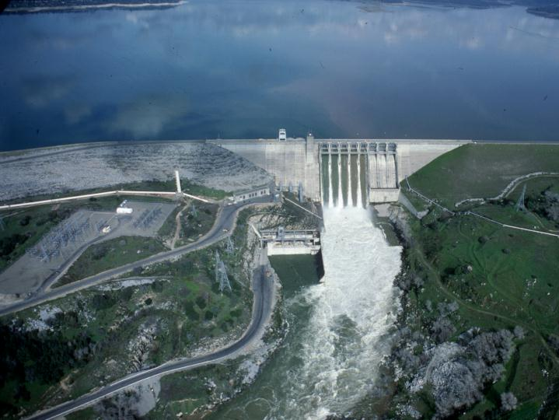
Folsom Dam
Dam type: Concrete gravity
Location: 20 miles northeast of Sacramento, California
Watercourse: American River
Reservoir: Folsom
Original construction: 1948-56

Slide 78
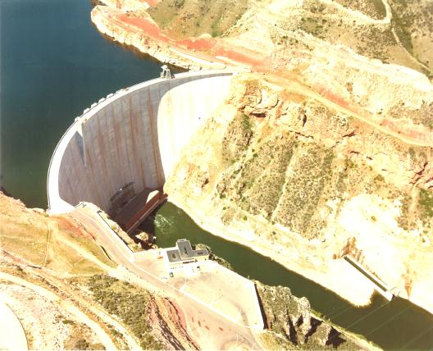
Yellowtail Dam
http://www.usbr.gov/cdams/dams/yellowtail.html

Slide 79
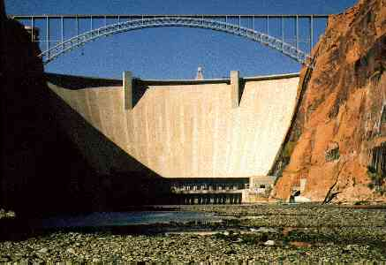
Glen Canyon

Slide 80
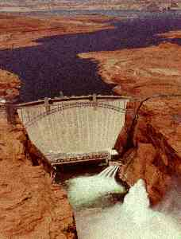
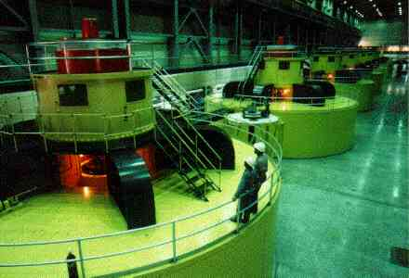
Glen Canyon

Slide 81
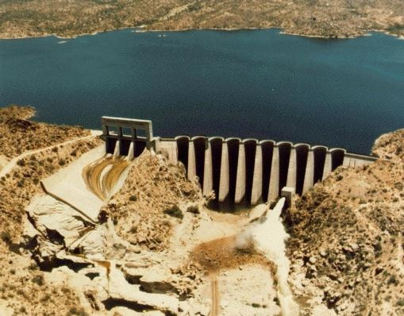
Bartlett Dam
http://www.usbr.gov/cdams/dams/bartlett.html

Slide 82
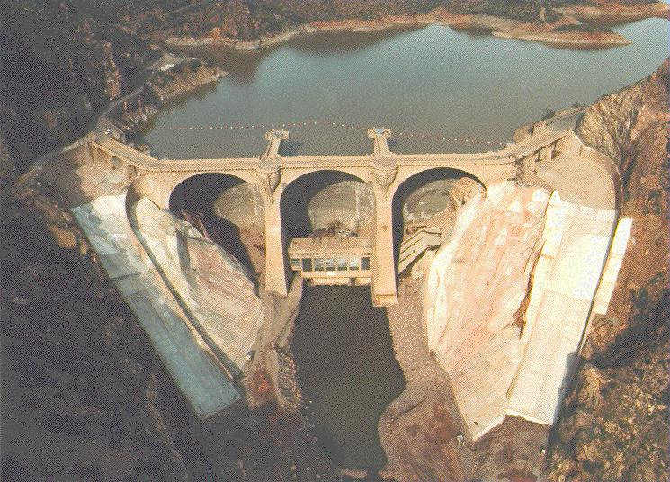
Coolidge Dam
http://www.usbr.gov/cdams/dams/coolidge.html

Slide 83

Stony Gorge Dam
http://www.usbr.gov/cdams/dams/stonygorge.html

Slide 84

Grand Coulee Dam
http://www.usbr.gov/cdams/dams/grandcoulee.html

Slide 85


Brantley Dam
http://www.usbr.gov/cdams/dams/brantley.html

Slide 86


Jackson Lake Dam
http://www.usbr.gov/cdams/dams/jacksonlake.html

Slide 87

Keswick Dam
Stilling basin
http://www.usbr.gov/cdams/dams/keswick.html

Slide 88

Shasta Dam
http://www.usbr.gov/cdams/dams/shasta.html

Slide 89


Cannonsville Reservoir
Cannonsville Reservoir

Slide 90
Cannonsville Reservoir Storage (Demand of 0.5 x 10⁶ m³/day)

Slide 91
Cannonsville Reservoir Storage (Demand of 0.75 x 10⁶ m³/day)

Slide 92
Cannonsville Reservoir Storage (Demand of 1 x 10⁶ m³/day)

Slide 93
Cannonsville Reservoir Storage (Demand of 1.04 x 10⁶ m³/day)
How could we increase safe yield?
Increase reservoir volume

Slide 94
Dam Dis-functions
Inundation of land
resettlement of communities
methane gas release from degrading organic matter
trap sediment
reservoir fills with sediment
clear water downstream causes erosion
sediment may have been source of nutrients for downstream farmland
cyclic loading of earth crust causes “reservoir induced earthquakes”
1967 Koyna earthquake killed 200 people after 50 m raise in reservoir level M 6.3
Oroville after a 50 m increase in reservoir elevation M 5.7
Aswan M 5.3

Slide 95
Dam Dis-functions
Obstruction of free flowing river
interfere with migration of fish
decrease aeration (river rapids can be a major source of reaeration) (significant on Ohio River)
decrease stream flow(water use for irrigation...)
decreased ability to dilute pollutants
variable stream flow(responding to electricity demands)
disrupt fish
decrease species diversity
hazard to humans
Impoundment of water
algae blooms
fish kills
nuisance species - Shistosoma in Africa, Asia, Caribbean

Slide 96
Reservoir Induced Earthquakes
By H.K. Gupta, Cochin University of Science and Technology, Cochin India, and Programs in Geosciences, The University of Texas at Dallas, Richardson, TX, USA
Description
Since the publication of the first Dams and Earthquakes in 1976, the phenomenon of reservoir induced seismicity (RIS) is more widely understood. There are now over 70 known cases of reservoir-induced earthquakes. These damaging earthquakes have occurred in China, Kariba, Zambia, Greece, Kremasta, Koyna, India, California and elsewhere. The December 10, 1967 Koyna earthquake, with a magnitude of 6.3 claimed over 200 lives, injured 1500 and rendered thousands homeless.
Because of the ever increasing demand for dam construction, for power generation, irrigation, and flood control, it is necessary to understand how, where and why induced earthquakes occur. Recent research has demonstrated that when suitable physical measurements of rock properties are made, a fairly accurate model of induced seismicity can be obtained. It appears possible to mitigate the hazard of RIS through manipulation of reservoir levels.
The present volume is an updated and revised follow-up to the 1976 book. It presents an overview of the world-wide distribution of RIS, the salient aspects of RIS at specific reservior sites where earthquakes of M 5 have occurred and where new results on RIS are reported, and how they differ from the normal earthquake sequences. An examination of the non-occurrence of induced earthquakes in the vicinity of the Himalyan reservoirs and other related topics such as: the size of the largest induced earthquake that could occur at a given reservoir site; prediction of induced earthquakes; and dam site investigations which should be completed during the planning and operation of the reservoirs are also included.

Slide 97


Itaipu

Slide 98

Gates at Itaipu: Why this shape?

Slide 99

Itaipu Turbines

